Slide 1
Romans 12:1-2

Slide 2
12 I appeal to you therefore, brothers, by the mercies of God, to present your bodies as a living sacrifice, holy and acceptable to God, which is your spiritual worship. ² Do not be conformed to this world, but be transformed by the renewal of your mind, that by testing you may discern what is the will of God, what is good and acceptable and perfect.

Slide 3
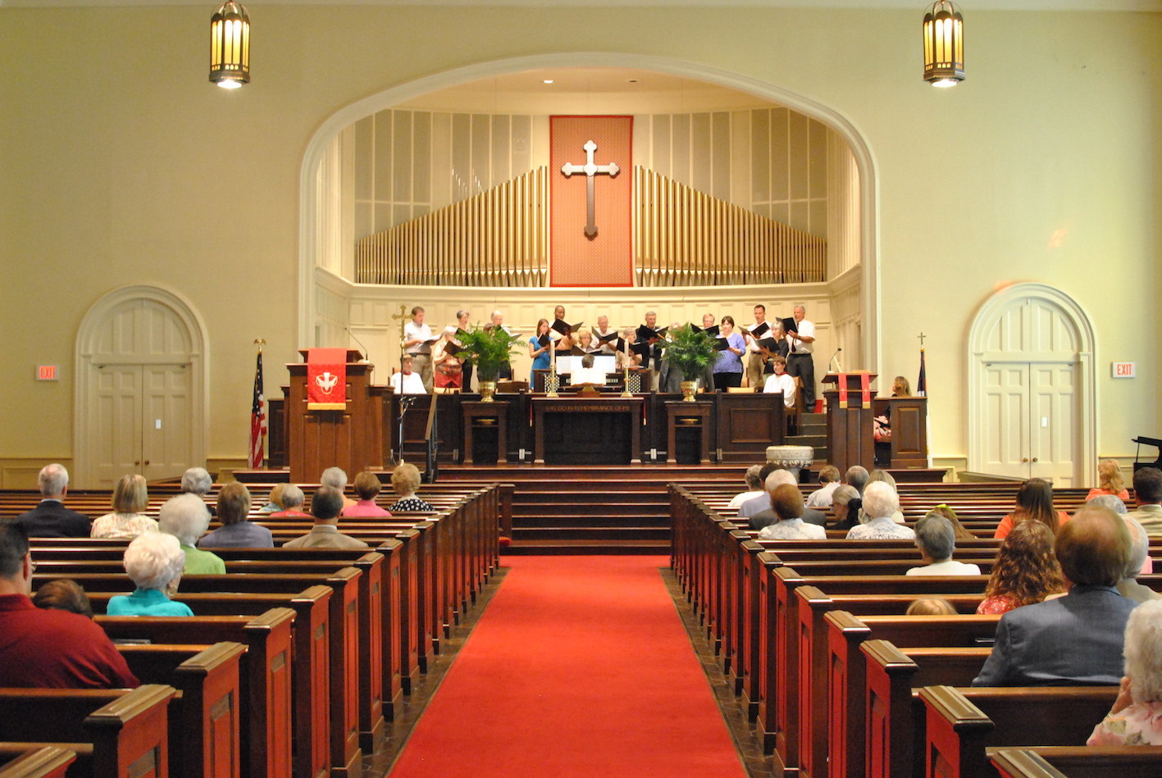
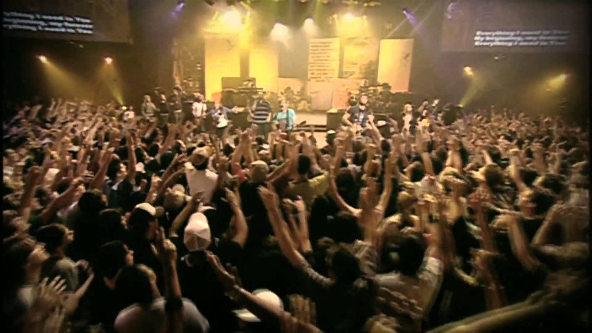
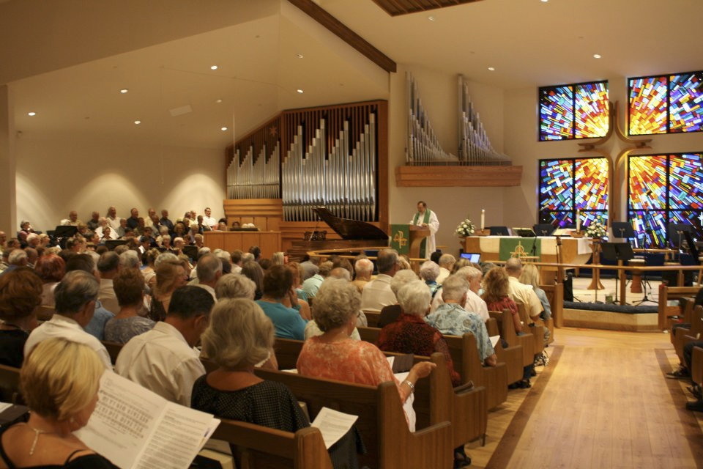
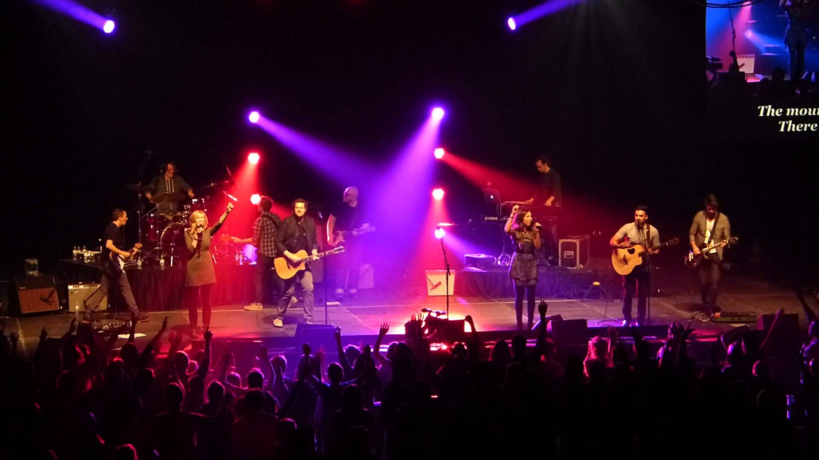
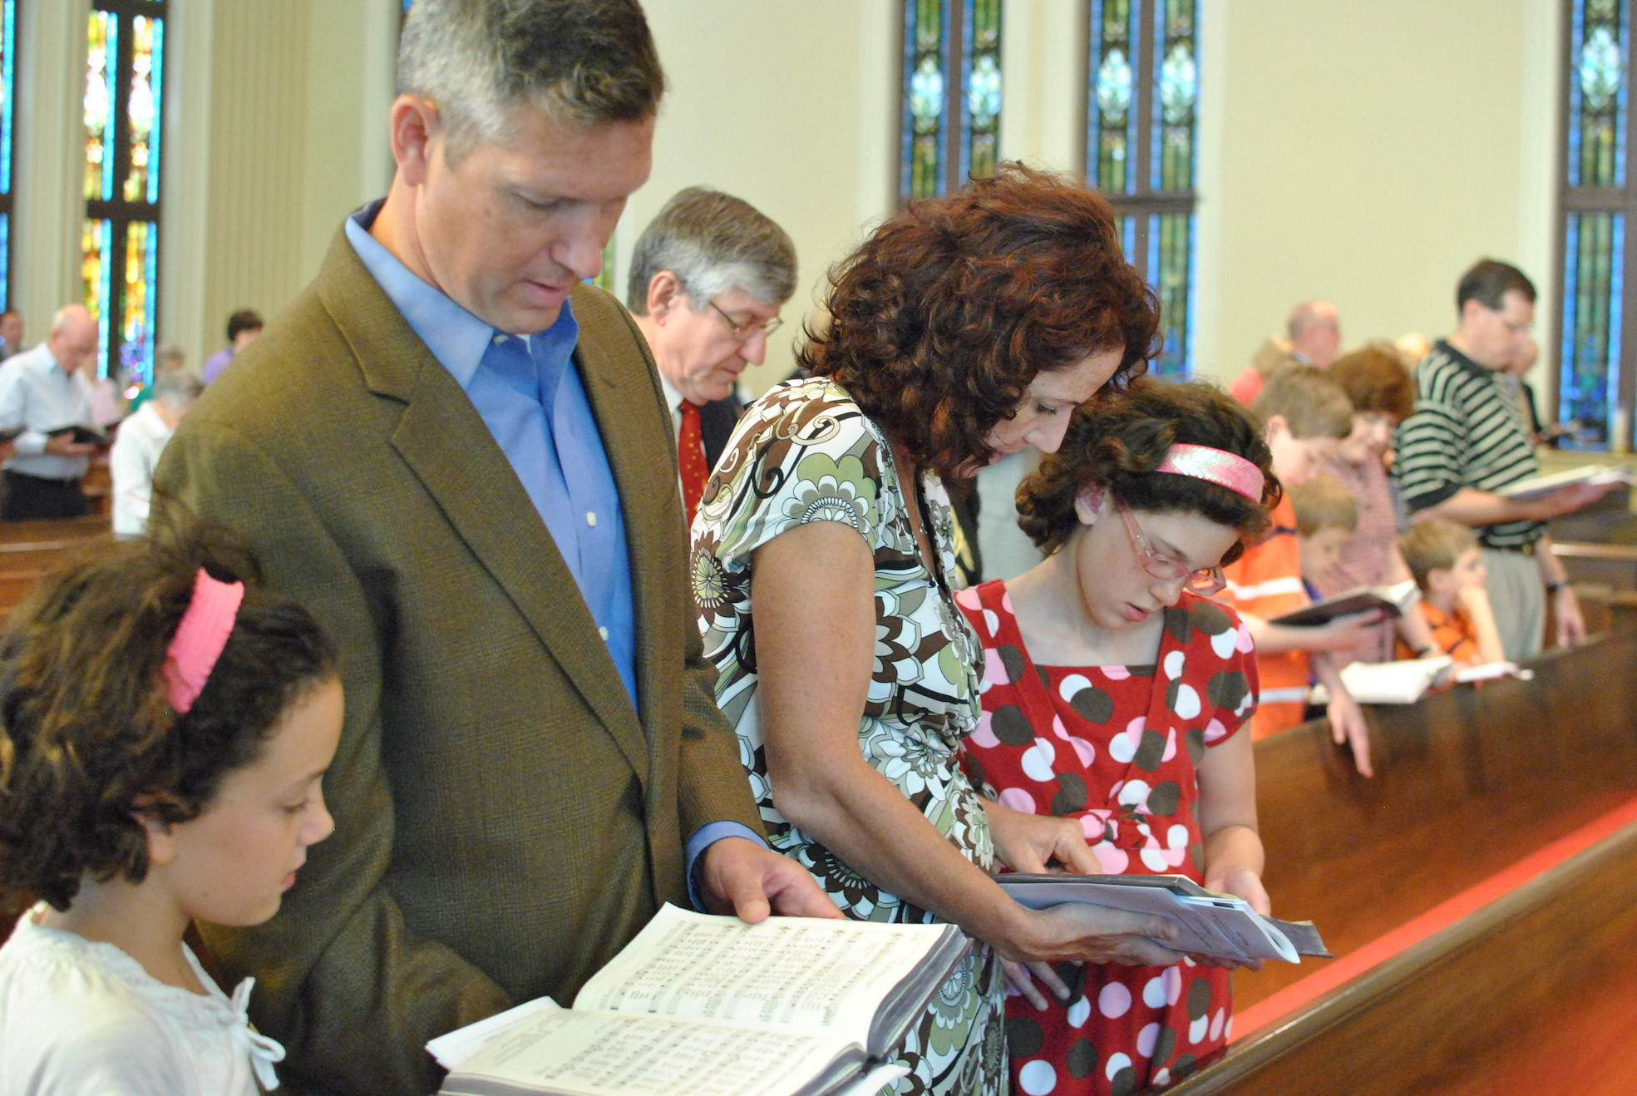

Slide 4
Worship is more than a song
True worship begins with Jesus
Christ and the One True God
Don’t be false in our worship (be real with God)
John 4:²³ … the hour is coming, and is now here, when the true worshipers will worship the Father in spirit and truth, …
I appeal to you…, to present your bodies as a living sacrifice, holy and acceptable to God, which is your spiritual worship.
ESV which is your spiritual worship.
KJV which is your reasonable service.
YLT your intelligent service;
NIV this is your spiritual act of worship.
    footnote: this is your reasonable act of worship
new NIV: this is your true and proper worship
λογικὴν (logikēn)
Intellectual; rational; reasonable; true; proper; Spiritual
the fallen world = false worship and a corrupt mind (Rom 1)
In Christ = true/proper/spiritual worship and a renewed mind

Slide 5
Isaiah 1:13–20
¹³ Bring no more vain offerings; incense is an abomination to me.
New moon and Sabbath and the calling of convocations—
I cannot endure iniquity and solemn assembly.
¹⁴ Your new moons and your appointed feasts my soul hates;
they have become a burden to me;
I am weary of bearing them.
¹⁵ When you spread out your hands, I will hide my eyes from you;
even though you make many prayers,
I will not listen;
your hands are full of blood.
¹⁶ Wash yourselves; make yourselves clean;
remove the evil of your deeds from before my eyes;
cease to do evil,

Slide 6
¹⁷ learn to do good; seek justice, correct oppression;
bring justice to the fatherless,
plead the widow’s cause.
¹⁸ “Come now, let us reason together, says YHWH:
though your sins are like scarlet,
they shall be as white as snow;
though they are red like crimson,
they shall become like wool.
¹⁹ If you are willing and obedient,
you shall eat the good of the land;
²⁰ but if you refuse and rebel,
you shall be eaten by the sword;
for the mouth of YHWH has spoken.”

Slide 7
present your bodies as a living sacrifice, holy and acceptable to God, which is your spiritual worship.
the fallen world = false worship and a corrupt mind (Rom 1)
In Christ = true/proper/spiritual worship and a renewed mind
God hates our worship, when our everyday lives are filled with iniquity
when we do evil and don’t do good
seek justice; correct oppression; care for the widow; and the fatherless...
Do not be conformed to the world (an ever-present temptation)
You must be transformed (metamorphosed)

Slide 8
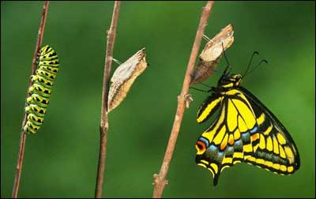

Slide 9
present your bodies as a living sacrifice, holy and acceptable to God, which is your spiritual worship.
the fallen world = false worship and a corrupt mind (Rom 1)
In Christ = true/proper/spiritual worship and a renewed mind
God hates our worship, when our everyday lives are filled with iniquity
when we do evil and don’t do good
seek justice; correct oppression; care for the widow; and the fatherless...
Do not be conformed to the world (an ever-present temptation)
You must be transformed (metamorphosed)
Agree with God that His way is right
we may continue to be influenced by the thinking of the world
Not about losing your mind. God renews our minds.
(To see sin & righteousness as He does. To love like He loves.)
If I don’t agree with God’s way, my mind needs renewal
2. Embrace God’s way, and live it.

